Slide 1






Atliq
Hardwares
Ad_Hoc Insights
Consumer Goods
Insights Presentation for Strategic Decisions in the Consumer Goods Sector

Slide 2

Atliq
Hardwares
Hello!
Warm greetings to everyone. I am pleased to present key insights gathered from the SQL challenge for Atliq Hardwares. Today, we will explore data-driven insights that address critical business questions and provide strategies to drive growth and efficiency across various segments.

Slide 3


Agenda Overview
01
Objective
02
Company's Details and Market
03
Dataset Structure, Challenge, and Tools
04
Conclusion
05
Queries

Slide 4


Objectives
Atliq Hardware (fictitious company) is a leading computer hardware manufacturer in India with a strong presence globally.
Management noted insufficient insights for making timely, data-informed decisions.
Plans are underway to expand the data analytics team by hiring junior analysts.
Tony Sharma, Data Analytics Director, will conduct a SQL challenge to evaluate candidates' tech and soft skills.
The challenge involves generating insights for 10 ad-hoc business requests.

Slide 5


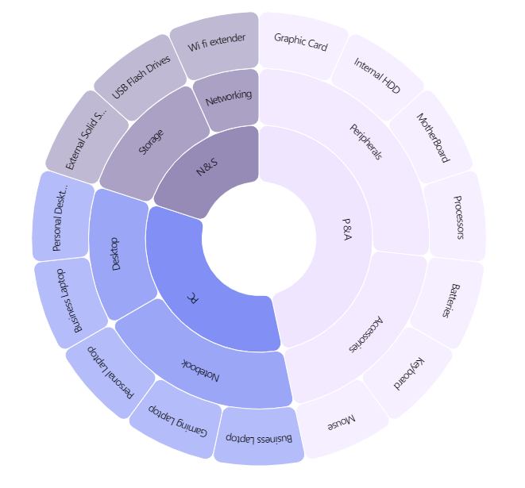


Company Details
Atliq Hardware is a manufacturer of computer hardware and accessories.
Outer Circle:
Category
FISCAL YEAR
SEPTEMBER 2019 - AUGUST 2020
FY 2020
SEPTEMBER 2020 - AUGUST 2021
FY 2021
Mid Circle:
Segment
Inner Circle:
Division

Slide 6

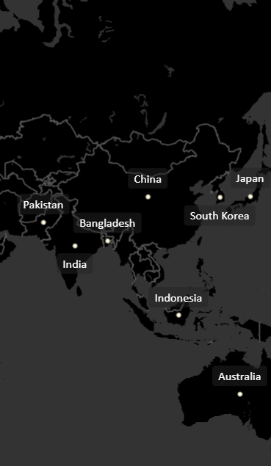
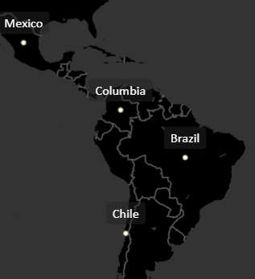
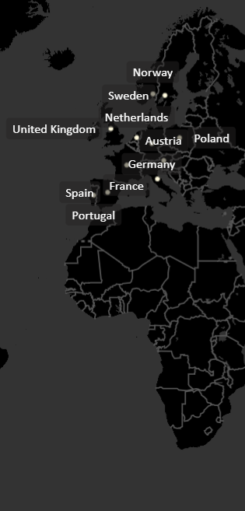

Company's Market
APAC
NA
EU
LATAM

Slide 7

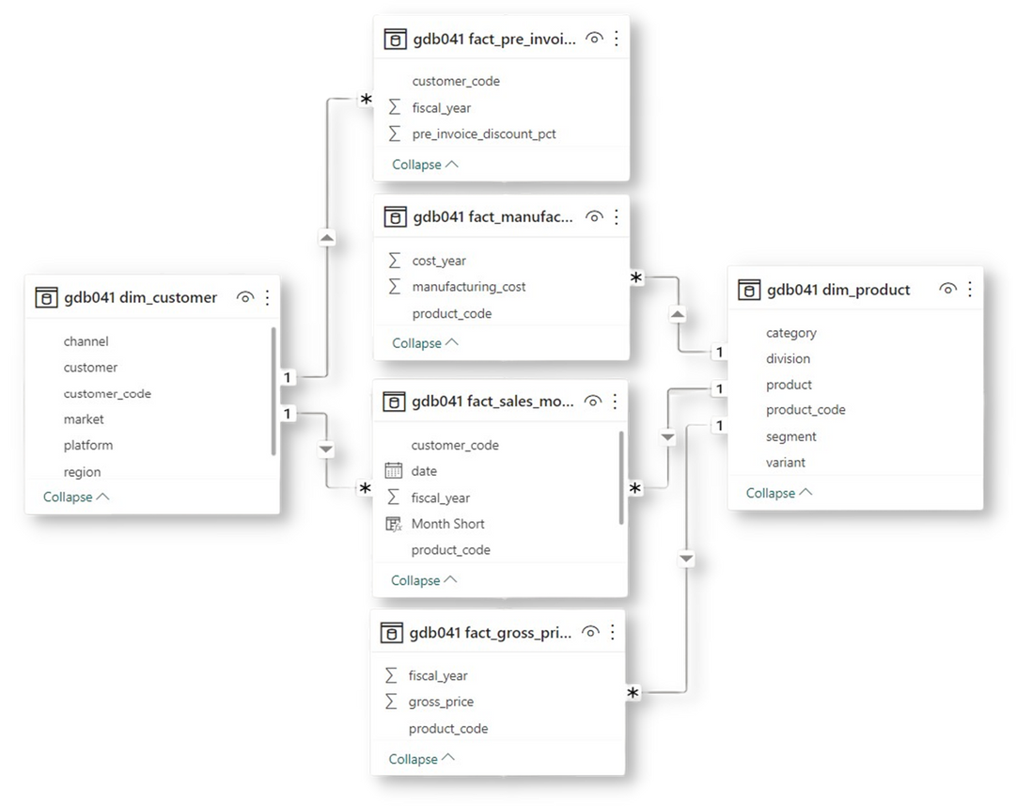
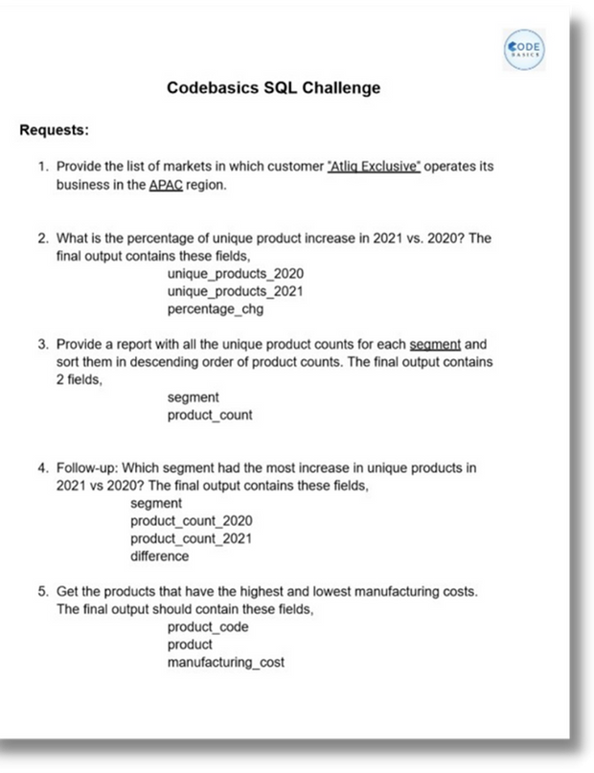
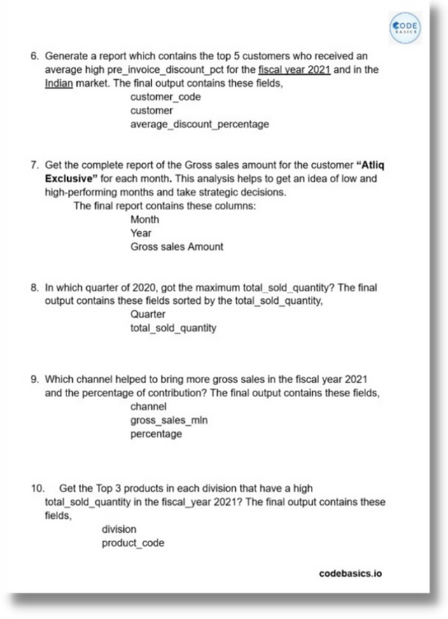

Dataset Structure, Challenge, and Tools
ForAnalysis and Visualization

Slide 8

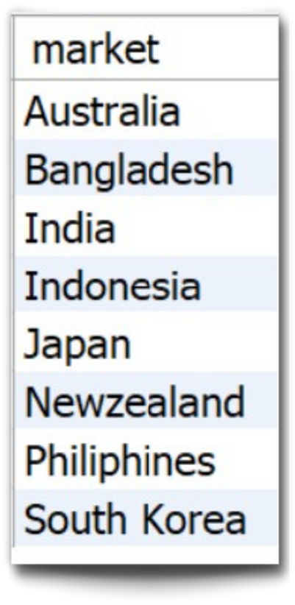
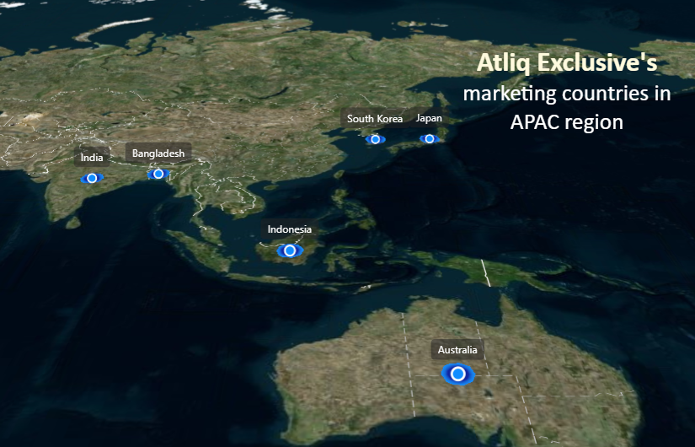

1. Provide the list of markets where customer "AtliqExclusive" operates its business in the APAC region.

Slide 9

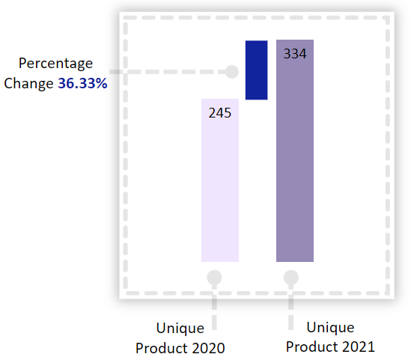
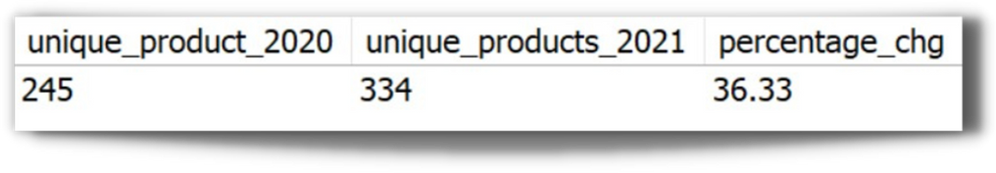
2. What is the percentage of unique product increase in 2021 vs. 2020? The final output contains these fields,
unique_products_2020
unique_products_2021
percentage_chg
Unique Products 2021
Vs
Unique Products 2020
Insight:
Both demand and production have shown an upward trend.

Slide 10

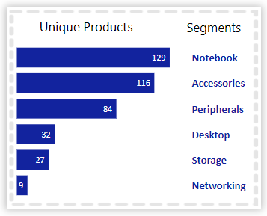
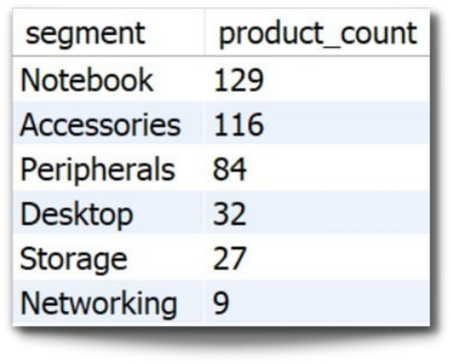

3. Provide a report with all the unique product counts for each segment and sort them in descending order of product counts. The final output contains 2 fields,
segment
product_count
Unique product counts for each segment
{
Insight:
Segments: notebooks, accessories, and peripherals are showing significant manufacturing growth as compared to desktops, storage, and networking.
Notebooks, accessories, and peripherals constitute 83% of the total manufactured product.
Alarming

Slide 11
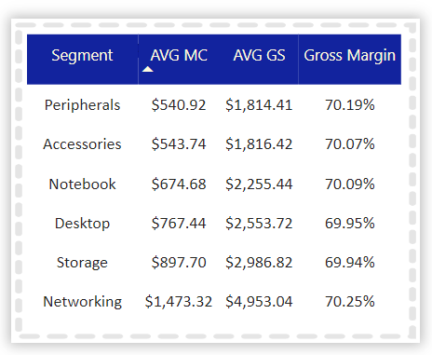
}
Wifi extender
USB Flash Drives
External Solid State Drives
Personal Desktop
Business Laptop
Suggestions :
Package Deal
Customer Services
Free Vouchers
Student Discount
Cash Back
Gift cards
Memberships
AVG MC: Average Manufacturing Cost
AVGGS: Average Gross Sales

Slide 12
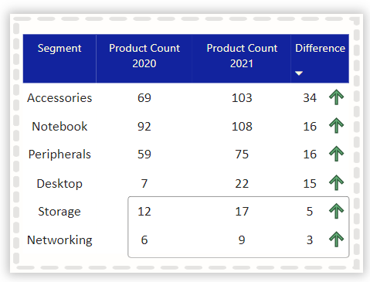
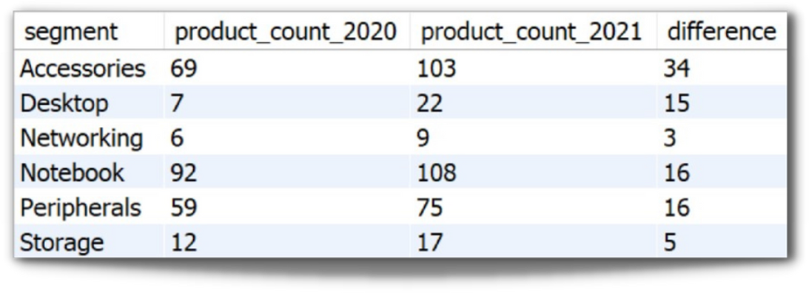
4. Follow-up: Which segment had the most increase in unique products in 2021 vs 2020? The final output contains these fields,
segment
product_count_2020
product_count_2021
difference
Unique product difference per segment from 2020 to 2021
Insight:
Accessories had the largest increase in production.
Storage and networking are experiencing slower production growth than other segments.

Slide 13
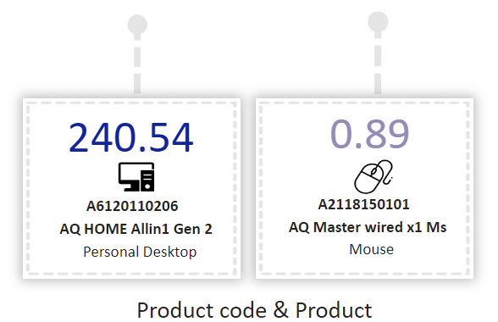
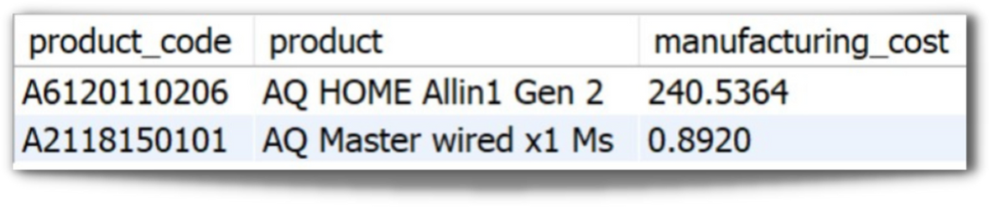
5. Get the products that have the highest and lowest manufacturing costs. The final output should contain these fields,
product_code
product
manufacturing_cost
Products having the
highest and lowest
manufacturing costs
Insight:
Mouse: AQ Master wired x1 Ms (Variant: Standard 1) has the lowest manufacturing cost.
PersonalDesktop: AQ Home Allin1 Gen2 (Variant: Plus 3) has the highest manufacturing cost.

Slide 14
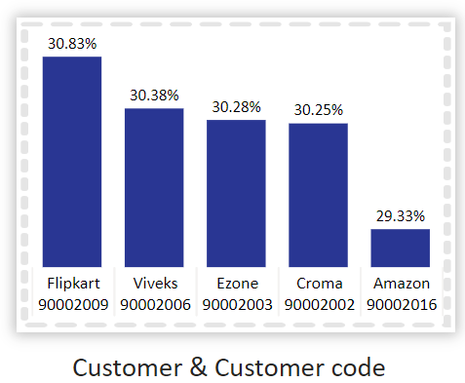
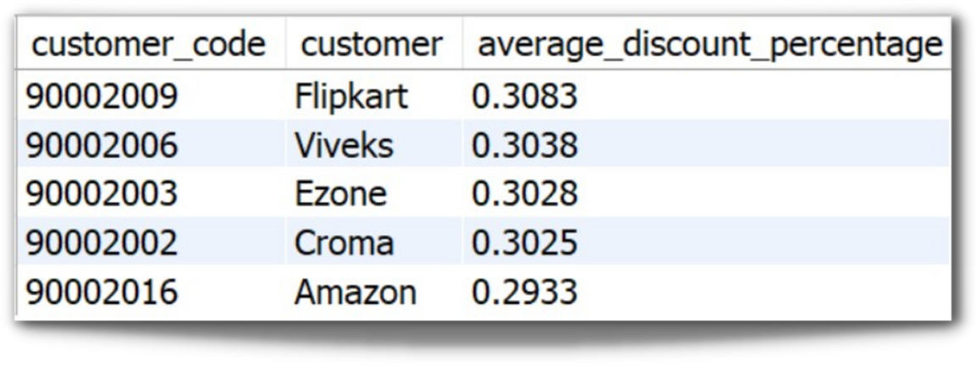
6. Generate a report which contains the top 5 customers who received an average high pre_invoice_discount_pct for the fiscal year 2021andin the Indian market. The final output contains these fields,
customer_code
customer
average_discount_percentage
Top 5 Indian customers with highest average discount percentage for FY 2021
Insight:
The largest average pre-invoice discount was given to Flipkart.
The least average pre-invoice discount was given to Amazon.

Slide 15
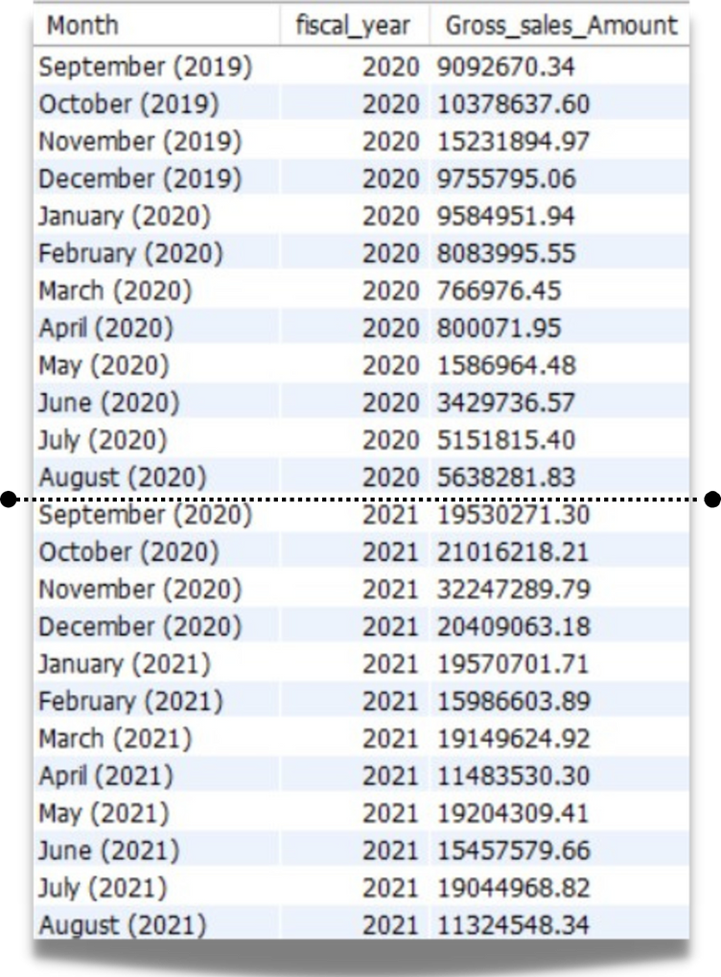
7. Get the complete report of the Gross sales amount for the customer “Atliq Exclusive” for each month. This analysis helps to get an idea of low and high-performing months and take strategic decisions. The final report contains these columns:
Month
Year
Gross sales Amount
FY 2020
79.5 M
Insight:
The lowest Gross sales total for both fiscal years is in March (2020).
The highest Gross sales total for both fiscal years is in November (2020).
73.8% of the total Gross sales figure is in FY 2021.
FY 2021
224.4 M

Slide 16
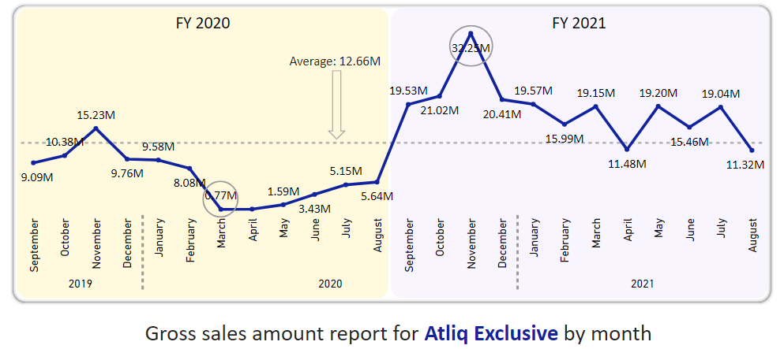
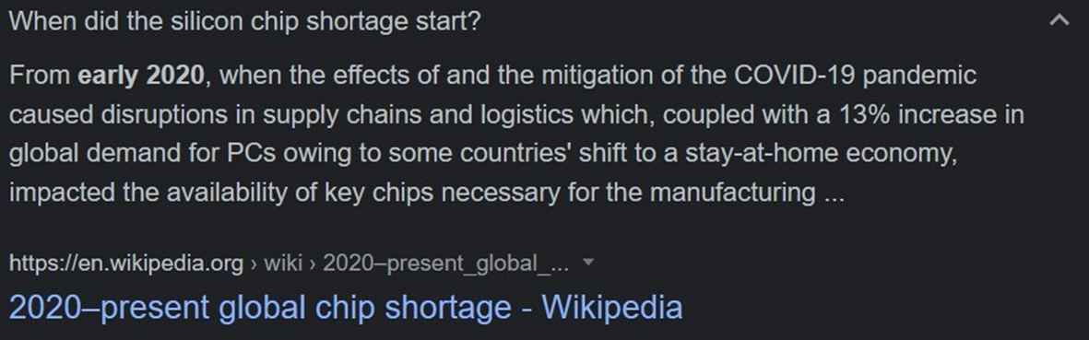
Reasons:
COVID-19
Global Chip shortage

Slide 17
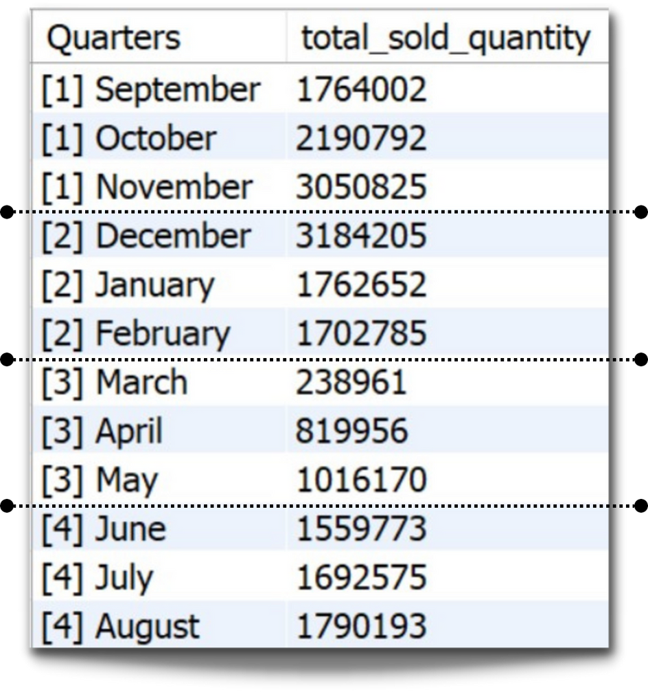
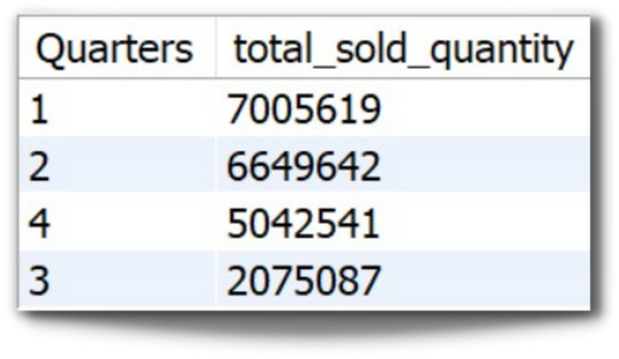
8. In which quarter of 2020, got the maximum total_sold_quantity? The final output contains these fields sorted bythetotal_sold_quantity,
Quarter
total_sold_quantity
Insight:
Quarter 1 of FY2020 saw the most units sold overall, while Quarter 3 had the fewest.
The highest and lowest overall sold quantity is in December and March.
Quarter 1 accounts for approximately 34% of the total sold quantity for FY2020.

Slide 18
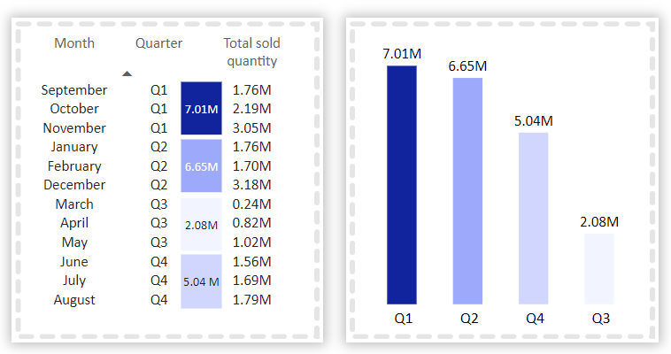
Total sold quantity in FY 2020 by Quarter

Slide 19
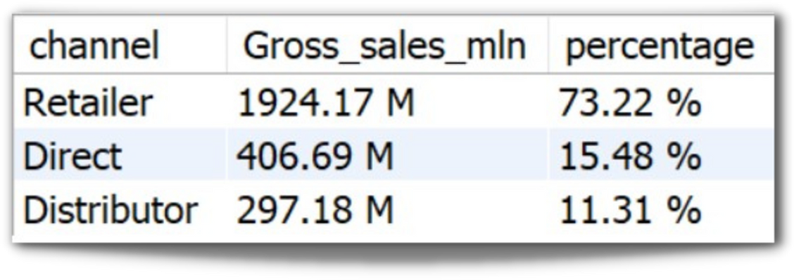
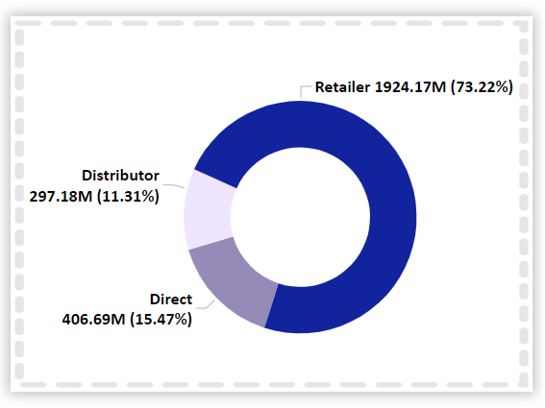

9. Which channel helped to bring more gross sales in the fiscal year 2021 and the percentage of contribution? The final output contains these fields,
channel
gross_sales_mln
percentage
Gross sales and contribution percentages by Channels for FY 2021
Insight:
Channel: "Retailer" helped bring maximum sales to the company with 73.22% as the contribution percentage.
Channel: "Distributor" makes the least contribution at a percentage of 11.31%.

Slide 20
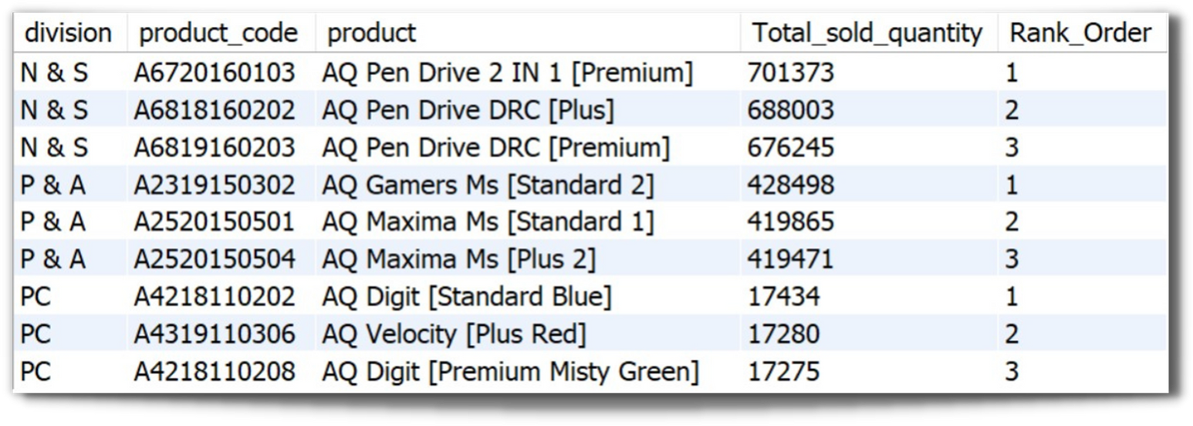
10. Get the Top 3products in each division that have a high total_sold_quantity in the fiscal_year 2021? The final output contains these fields,
division
product_code
product
total_sold_quantity
rank_order
Insight:
Every division has a product with different variants that appears twice in the top three products by division list.

Slide 21
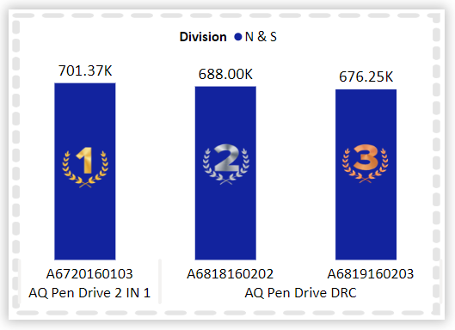
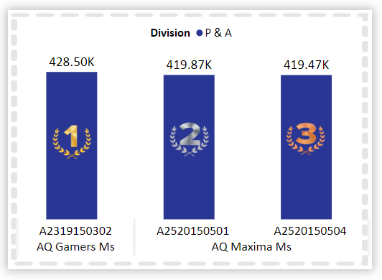
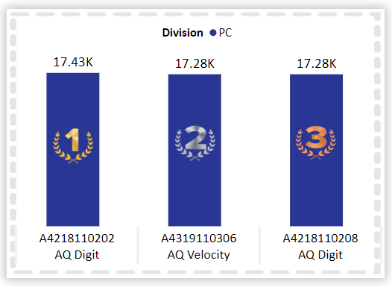
Top 3 highest-selling products by Division for FY 2021
Premium
Plus
Premium
Standard
Blue
Plus
Red
Premium
Misty Green
Standard2
Standard1
Plus2

Slide 22
Conclusion
Both demand and production have shown an overall increase, indicating strong market growth.
Notebooks, accessories, and peripherals dominate the manufacturing segment, contributing 83% of total production, with accessories experiencing the highest production growth.
Storage and networking segments show slower growth compared to other categories.
Manufacturing costs vary significantly, with the lowest for the AQ Master wired x1 Ms mouse and the highest for the AQ Home Allin1 Gen2 desktop.
Sales trends highlight November as the peak sales month, with March being the lowest. FY 2021 contributed the majority (73.8%) of gross sales.
Quarter 1 of FY2020 led in overall units sold, with the "Retailer" channel driving 73.22% of total sales.
Multiple divisions feature products with different variants consistently ranking among the top three in their respective categories.

Slide 23
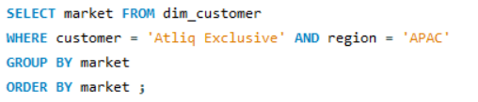
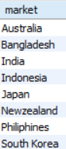
Queries :
1. Provide the list of markets where customer "AtliqExclusive" operates its business in the APAC region.

Slide 24
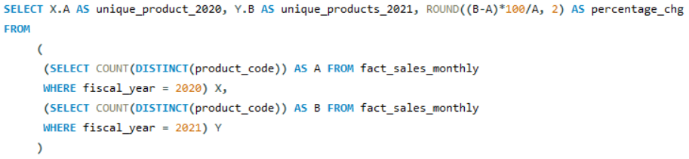
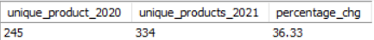
Queries :
2. What is the percentage of unique product increase in 2021 vs. 2020? The final output contains these fields,
unique_products_2020
unique_products_2021
percentage_chg

Slide 25
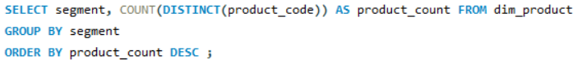
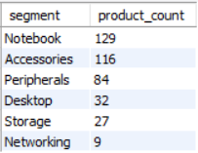
Queries :
3. Provide a report with all the unique product counts for each segment and sort them in descending order of product counts. The final output contains 2 fields,
segment
product_count

Slide 26
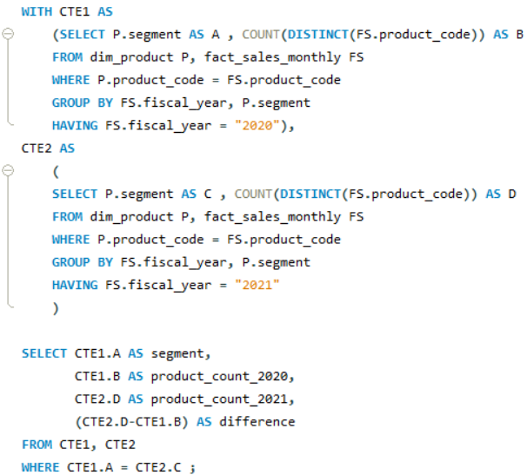
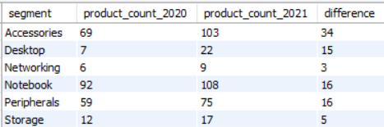
Queries :
4. Follow-up: Which segment had the most increase in unique products in 2021 vs 2020? The final output contains these fields,
segment
product_count_2020
product_count_2021
difference

Slide 27

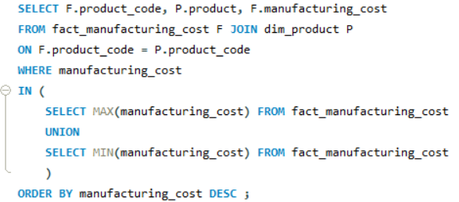
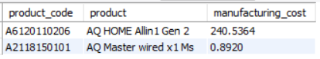
Queries :
5. Get the products that have the highest and lowest manufacturing costs. The final output should contain these fields,
product_code
product
manufacturing_cost

Slide 28
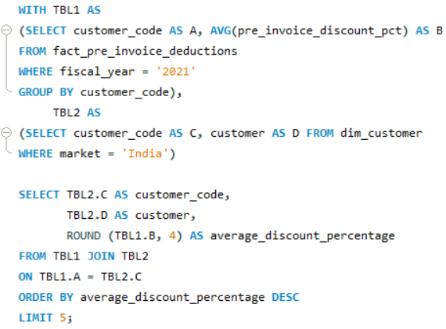
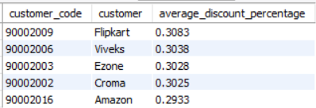
Queries :
6. Generate a report which contains the top 5 customers who received an average high pre_invoice_discount_pct for the fiscal year 2021andin the Indian market. The final output contains these fields,
customer_code
customer
average_discount_percentage

Slide 29
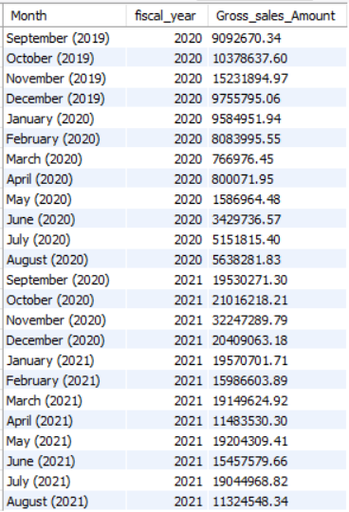
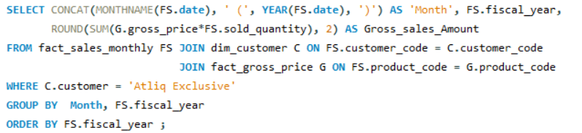
Queries :
7. Get the complete report of the Gross sales amount for the customer “Atliq Exclusive” for each month. This analysis helps to get an idea of low and high-performing months and take strategic decisions. The final report contains these columns:
Month
Year
Gross sales Amount

Slide 30
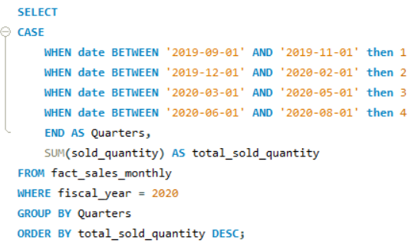
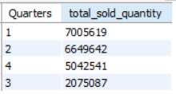
Queries :
8. In which quarter of 2020, got the maximum total_sold_quantity? The final output contains these fields sorted bythetotal_sold_quantity,
Quarter
total_sold_quantity

Slide 31
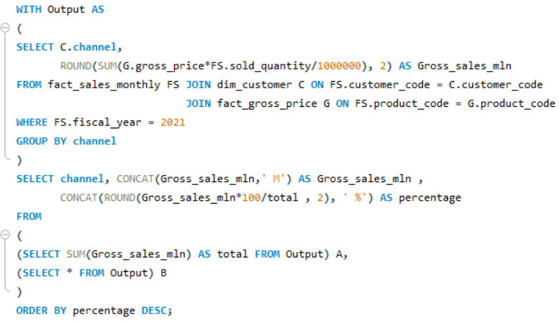
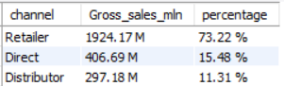
Queries :
9. Which channel helped to bring more gross sales in the fiscal year 2021 and the percentage of contribution? The final output contains these fields,
channel
gross_sales_mln
percentage

Slide 32


Queries :
10. Get the Top 3products in each division that have a high total_sold_quantity in the fiscal_year 2021? The final output contains these fields,
division
product_code
product
total_sold_quantity
rank_order

Slide 33

Thank You

